Slide 1
WHY BUSINESS MODEL? A business model is defined as a plan or a strategy that outlines how a business creates and capture values

Slide 2
AS YOU SOW SO SHALL YOU REAP
Value creation
Value capture

Slide 3
A business model can often beat a good idea or technology

Slide 4
Parameters of a business model:
Value proposition
Target market
Value chain
Revenue mechanism
Value network
Competitive strategy

Slide 5

Business Model Framework

Slide 6

Business Model Framework
‘‘ The Business Model Framework (BMF) is a model that sequences possible business models from very basic (and not very valuable) models to far more advanced (and very valuable) models. ’’

Slide 7

Types:
Type 1 – Undifferentiated Business Model
Type 2 – Some Differentiation in Business Model
Type 3 – Segmented Business Model
Type 4 – Externally Aware Business Model
Type 5 – Integrated Innovation Process with Business Model
Type 6 – Adaptive Platform Business Model

Slide 8

Type 1 – Undifferentiated Business Model
What it means: Companies with an undifferentiated business model operate without a clear strategy. They compete primarily on price and availability, offering basic products or services without significant uniqueness.
Example: Think of a regular fast-food place or a simple local barber shop. They offer what many others do, nothing special.

Slide 9

Type 2 – Some Differentiation in Business Model
Description: Companies in this category introduce some uniqueness to their products or services. While they may not be radically different, there's an effort to stand out, allowing them to target a specific customer segment beyond those solely focused on price.
Example: Think of a tech startup with a new gadget that has features not found in other products. It attracts customers looking for something a bit special, but sustaining this uniqueness can be challenging.

Slide 10

Type 3 – Segmented Business Model
Description: Companies with a segmented business model strategically cater to different customer segments simultaneously. This allows them to serve a broader market, extracting more profit. Different segments may include price-sensitive customers and those willing to pay more for premium features.
Example: Consider a company that manufactures both basic, affordable models of a product and high-end, premium versions. This approach helps capture diverse market segments.

Slide 11

Type 4 – Externally Aware Business Model
Description: Businesses in this type actively engage with external ideas and technologies. They collaborate with outside partners, reducing costs, and sharing risks. This external openness expands the company's resources and accelerates product development.
Example: Tech companies forming partnerships with startups or embracing open-source collaborations to incorporate external innovations into their products.

Slide 12

Type 5 – Integrated Innovation Process with Business Model:
Description: In this type, companies closely connect how they do business with how they come up with new and better ideas. They work closely with customers and suppliers to understand what people want. The company doesn't just sell products; it actively experiments with different ways of offering services and explores new ways to make money.
Example: Imagine a company that used to sell DVDs but now offers a streaming service. They not only watch what customers like but also work with others to improve their services. This type is all about adapting the business based on what customers want and experimenting with new ideas.

Slide 13

Type 6 – Adaptive Platform Business Model:
Description: This type is like the super flexible and always trying new things model. Companies in this type don't just stick to one way of doing business; they keep experimenting with different ideas. They might invest in new small companies (like giving them money to grow), try out completely new ways of doing business, or even create special places inside the company just for testing new ideas.
Example: Think of big companies like Intel or Microsoft as cool inventors. They don't just make things; they actively support and invest in new, small companies. They're always testing new ideas and ways of doing business.

Slide 14
Challenges IN BUSINESS MODEL INNOVATION

Slide 15
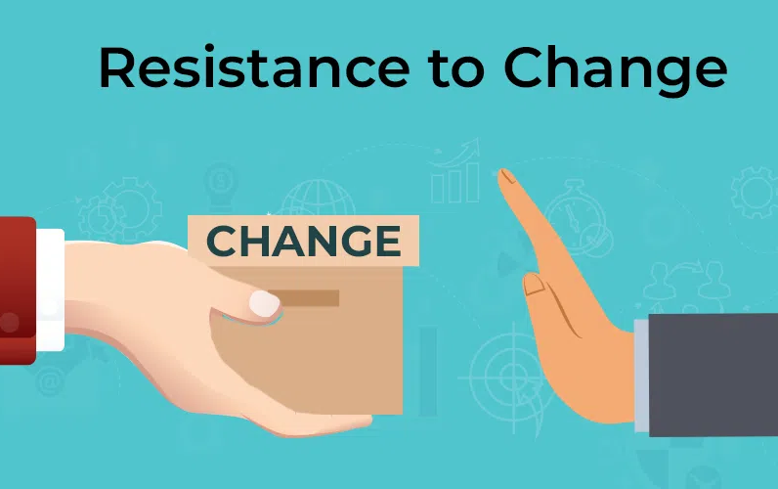
Resistance to Change
One of the primary challenges in business model innovation is the resistance to change. Employees, management, and stakeholders may be accustomed to existing processes and may resist adopting new models.

Slide 16

Risk Aversion
Companies may be risk-averse, especially if the existing business model has been successful in the past. Fear of failure can hinder experimentation with new models, preventing organizations from realizing potential benefits.

Slide 17
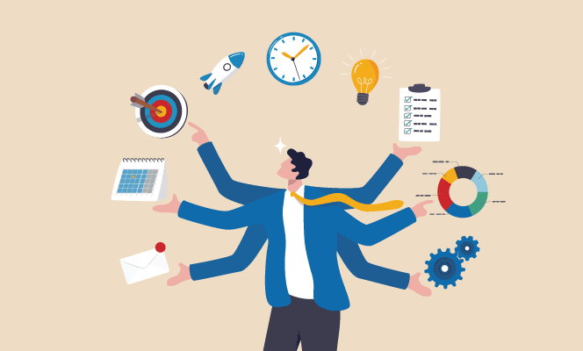
Resource Constraints
Trying a new way of doing business takes a lot of resources like money, skilled workers, and time. Many companies might find it hard to get these resources, making it tough for them to try out new and innovative ideas.

Slide 18

Customer Acceptance
Shifting to a new business model may impact existing customer relationships. Ensuring that customers accept and adapt to the changes is crucial for the success of the innovation. Companies need to communicate effectively and manage customer expectations during the transition.

Slide 19

Competitive Pressures
The competitive landscape is dynamic, and other players in the market may also be exploring innovative business models. Companies need to stay ahead of or at least keep pace with competitors to maintain their market position.

Slide 20

Cultural Alignment
Making sure the way a company works matches with the new business idea is really important for it to succeed. Sometimes, the company's way of thinking and doing things might need to change to encourage new ideas, working together, and being open to doing things differently.

Slide 21

Technological Integration
If the new business model involves the adoption of new technologies, integrating these technologies seamlessly into existing systems can be a complex task.

